Slide 1
Exercise 3.3.1
The points are not blue, because the colour layer is specified within the aes mapping. The correct code would be to set the color manually in the geom_point method.
2.ggplot(data = mpg) + geom_point(mapping = aes((x = displ, y = hwy),color = “blue”)
3. Categorical variables include: manufacturer ,model , trans , fl , class
Continuous: displ ,year ,cyl ,drv , cty , hwy. I can see this by running mpg then conclude those that are characters<char> are categorical then those with int ,double and float are continuous
4.For continuous variable a legend is shown but for categorical nothing is shown.
5. Both aesthetics are applied.
6. Stroke seems to adjust the plotted thickness.
7. It does exactly what the condition says different color for displ below 5 and different for displ above 5.

Slide 2
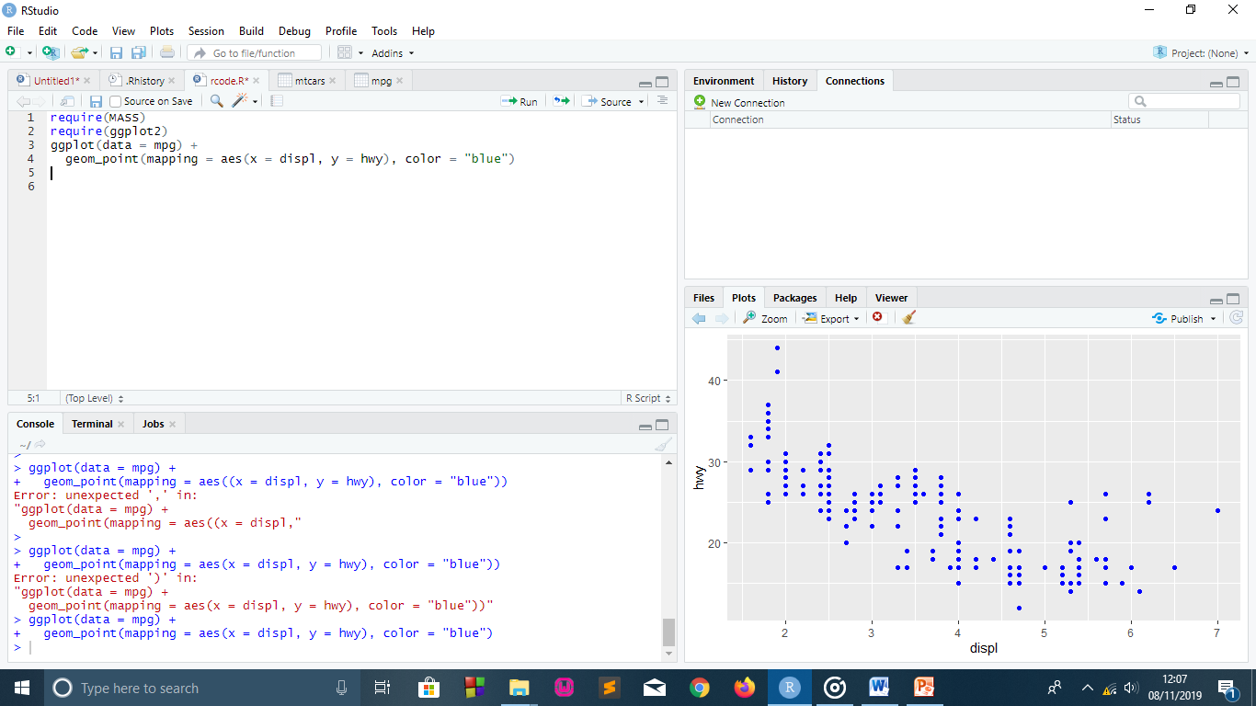

Slide 3
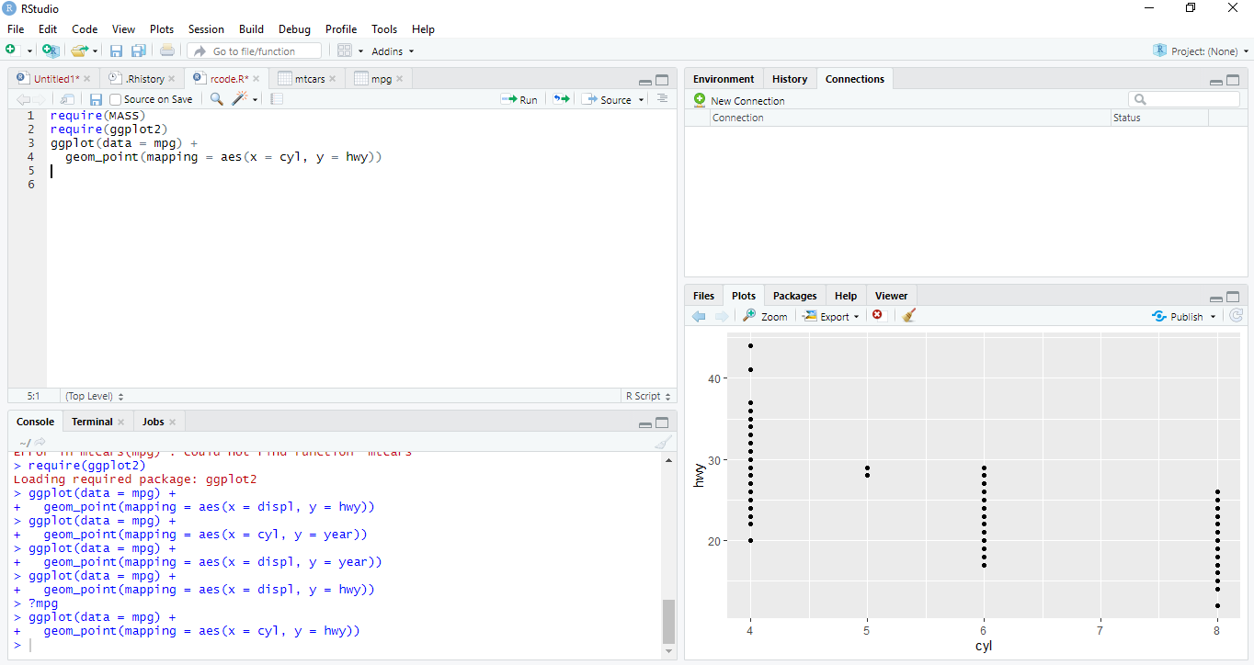

Slide 4
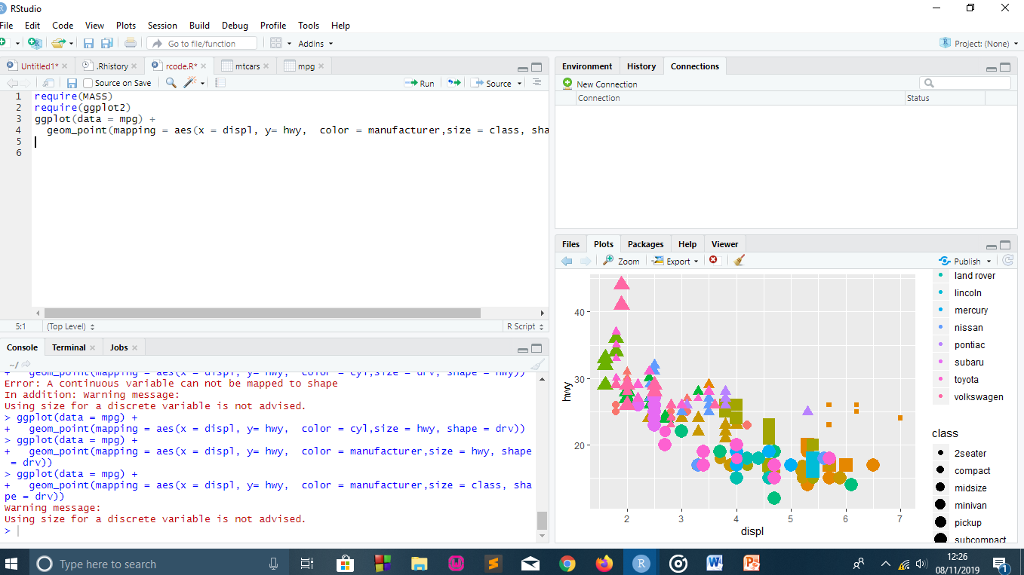

Slide 5
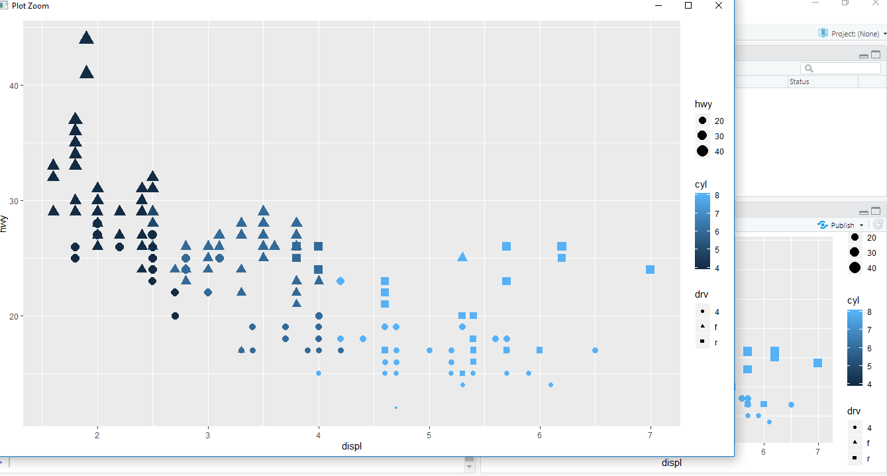

Slide 6
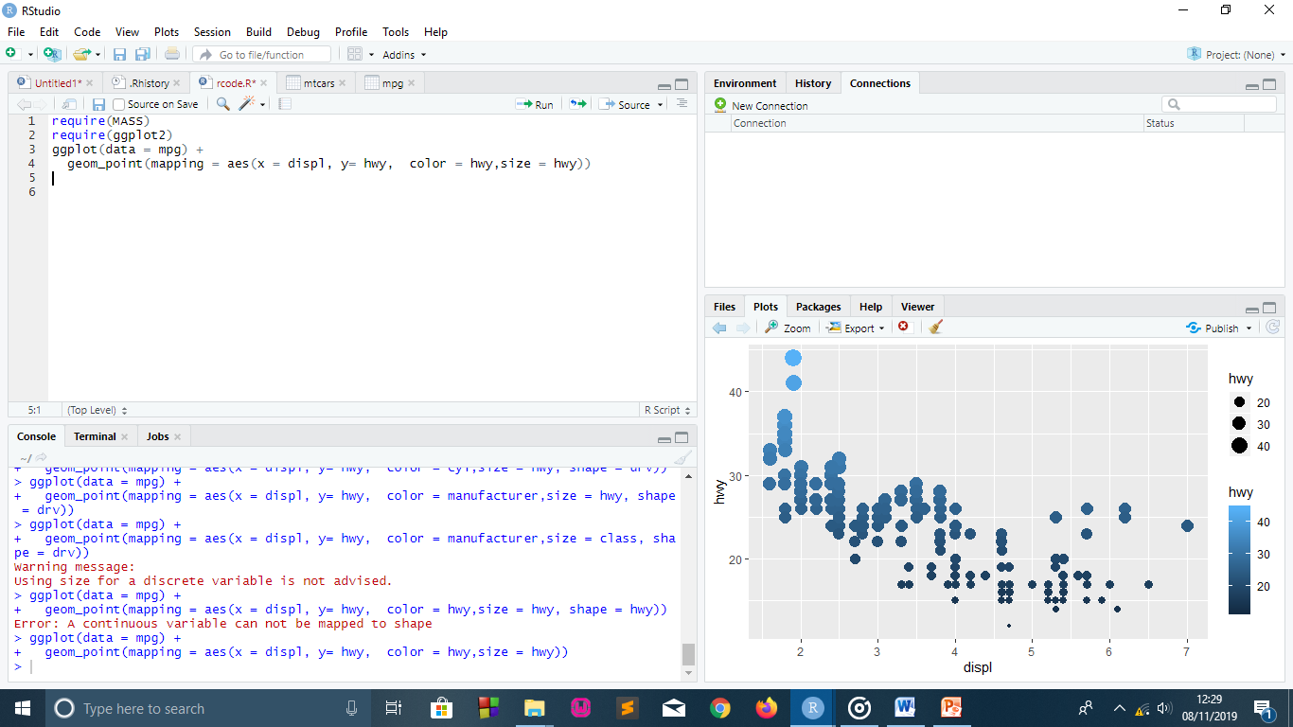

Slide 7
